Slide 1

Introduction to Software Development Methodologies and Core Concepts
Understanding Agile, Waterfall, Encapsulation, Logic Gates, and Graph Traversal

Slide 2

Learning Objectives
- Understand Agile, Waterfall, and DevOps methodologies.
- Explore logic gates and their applications in computing.
- Learn the concept of encapsulation and its importance.

Slide 3

What are Software Development Methodologies?
- Frameworks for planning, structuring, and controlling the process of developing software.
- Common methodologies: Waterfall, Agile, and DevOps.

Slide 4

The Waterfall Methodology
- Sequential design process:
Requirements → Design → Implementation → Verification → Maintenance.
- Best for projects with clearly defined requirements.

Slide 5
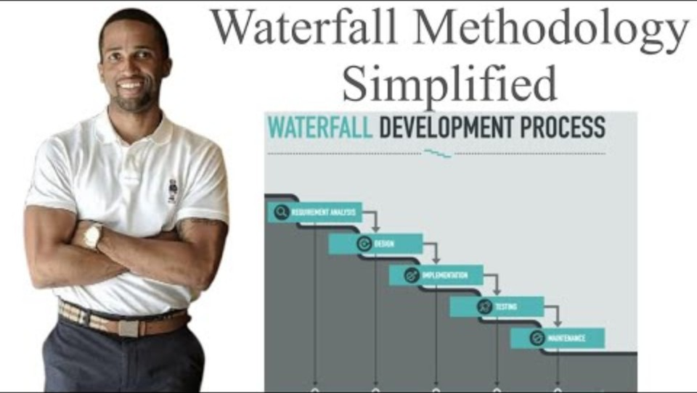
Waterfall Model
Notes:
https://www.youtube.com/watch?v=ux29TXUzwU4

Slide 6

The Agile Methodology
Emphasizes collaboration, adaptability, and incremental delivery.
- Key practices: Daily stand-ups, sprints, burndown charts. (sounds like yoga yesterday)

Slide 7
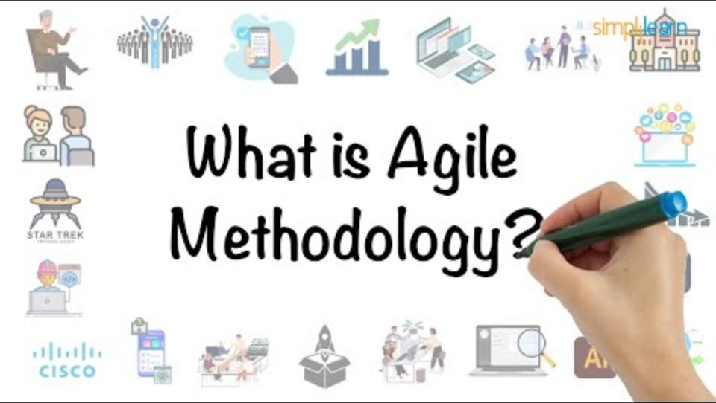

Slide 8
DevOps and CI/CD - how can this link to agile and waterfall?
DevOps and CI/CD link to Agile and Waterfall methodologies in distinct ways, emphasizing collaboration and efficiency in the software development lifecycle.
What is DevOps?
DevOps is a culture, methodology, and set of practices that bridge the gap between development (Dev) and operations (Ops). It promotes continuous integration, delivery, and deployment (CI/CD) to streamline the development and deployment processes.
Key Components of DevOps:
Continuous Integration (CI): Automatically integrating and testing code changes.
Continuous Delivery (CD): Ensuring code is always ready for deployment.
Continuous Deployment: Automatically deploying updates after passing tests.

Slide 9

Link to Agile
DevOps complements Agile by:
Supporting iterative development: Agile promotes incremental delivery of small, usable software pieces. DevOps ensures these are continuously integrated and deployed.
Faster feedback loops: Agile focuses on responding to change quickly, and CI/CD enables rapid testing and delivery to users.
Collaboration emphasis: Like Agile, DevOps fosters cross-functional teamwork between developers, testers, and operations.

Slide 10

Link to Waterfall
While Waterfall is a more sequential process:
Challenges in Waterfall: The lack of iterative updates makes it less compatible with continuous delivery. However, elements of CI/CD can be retrofitted for testing and deployment phases.
Modern Usage: Some Waterfall-based projects may incorporate DevOps tools during specific stages (e.g., testing automation).
DevOps thrives in Agile environments due to its iterative and adaptable nature, but its tools and practices can enhance Waterfall’s more structured workflows in a limited capacity.

Slide 11
Team Task: Planning a Simple Website - Waterfall vs. Agile
Waterfall Team: Focus on planning the project using the Waterfall Model.
Agile Team: Focus on planning the project using the Agile Model.

Slide 12
What are Logic Gates?
Logic gates are the building blocks of digital systems and represent simple decision-making operations in computing.
They take binary inputs (0s and 1s) and produce a binary output based on the gate's type.
Logic gates are essential for:
Automating decisions in DevOps pipelines (e.g., CI/CD conditions).
Modelling workflows in Agile and Waterfall using decision trees.
Notes:
1. Breadth-First Search (BFS)
What is BFS?
BFS explores a graph layer by layer.
Starting from a source node, it visits all neighboring nodes at the current depth level before moving to the next depth level.
Key Features:
Uses a queue data structure to track nodes.
Ensures the shortest path is found in an unweighted graph.
Ideal for solving problems like finding the shortest path in a maze or a social network.
Example Use Cases:
Pathfinding algorithms (e.g., Google Maps navigation).
Peer-to-peer networking (e.g., file sharing).
Web crawling (exploring links layer by layer).
2. Depth-First Search (DFS)
What is DFS?
DFS explores as deep as possible along one branch before backtracking to explore other branches.
Key Features:
Uses a stack (or recursion) to keep track of nodes.
Does not guarantee the shortest path.
Efficient for exploring all possibilities, such as solving puzzles.
Example Use Cases:
Detecting cycles in a graph.
Solving maze problems.
Parsing syntax trees in compilers.

Slide 13

Types of Logic Gates
AND Gate: Outputs 1 if all inputs are 1.
OR Gate: Outputs 1 if at least one input is 1.
NOT Gate: Inverts the input (1 becomes 0, and 0 becomes 1).
XOR, NAND, NOR: Used for more complex operations and conditions.

Slide 14
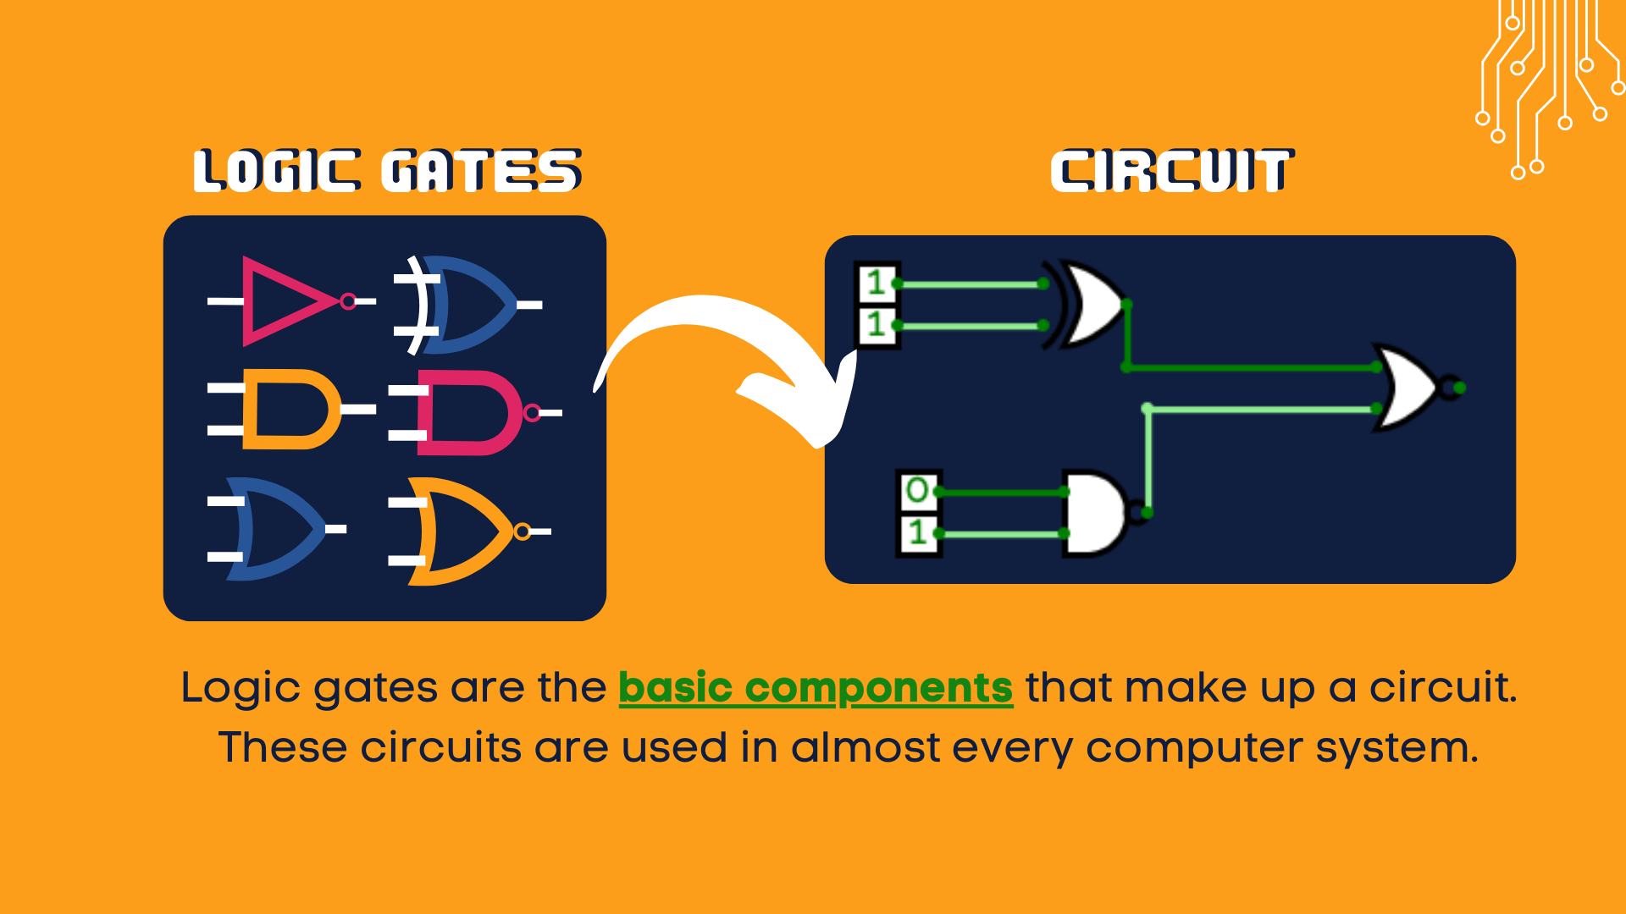

Slide 15
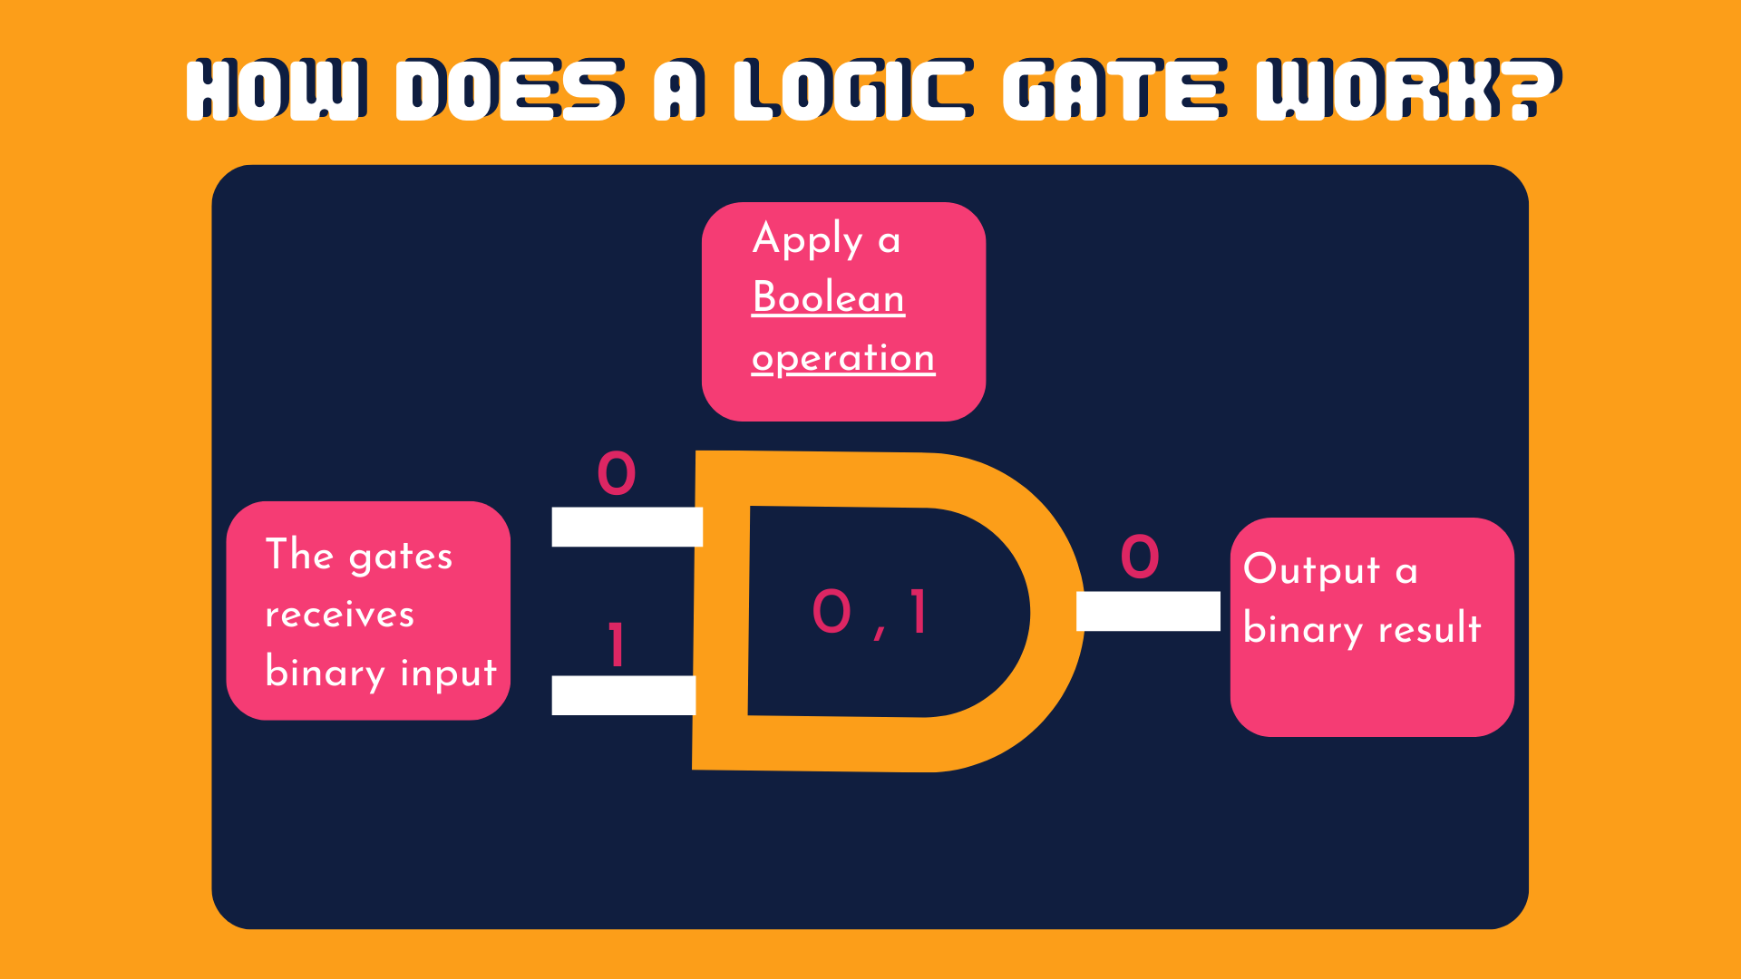

Slide 16
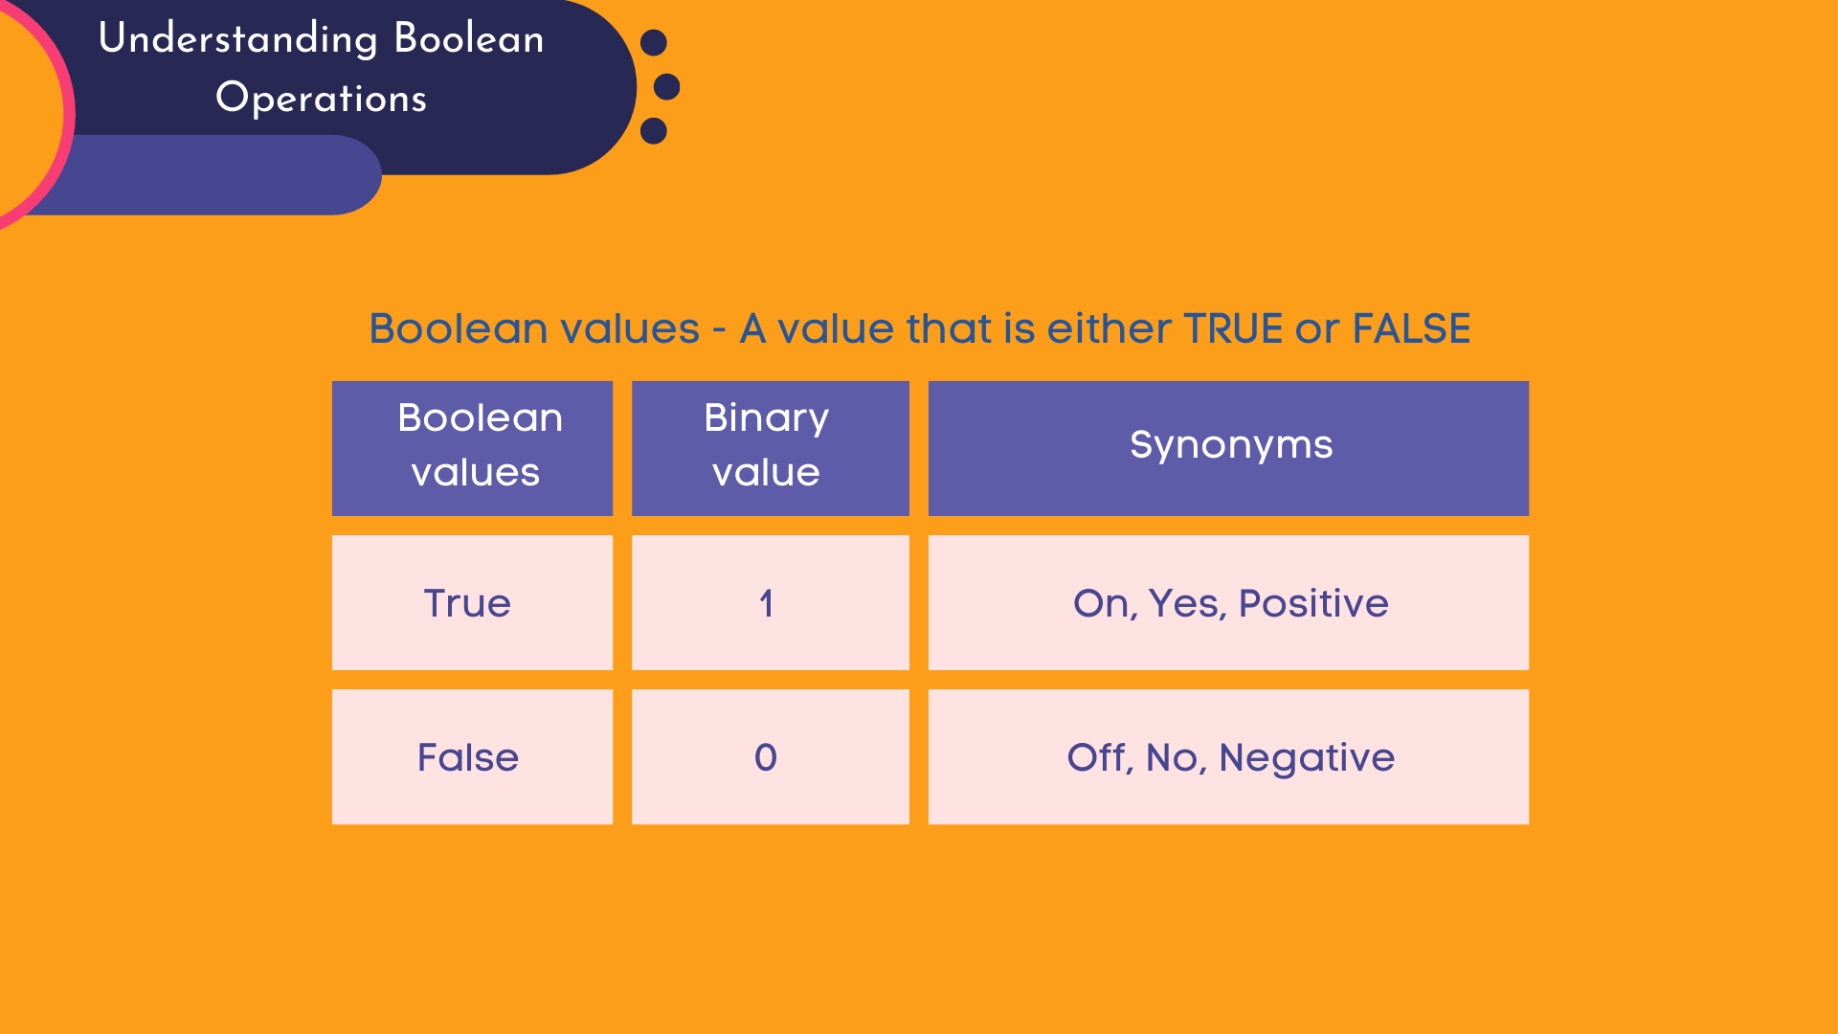

Slide 17
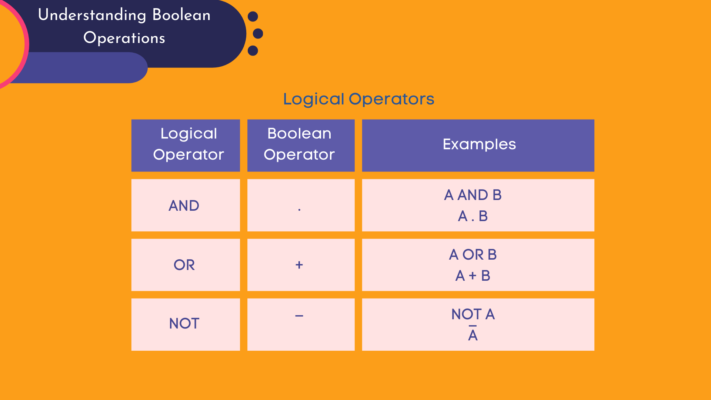

Slide 18
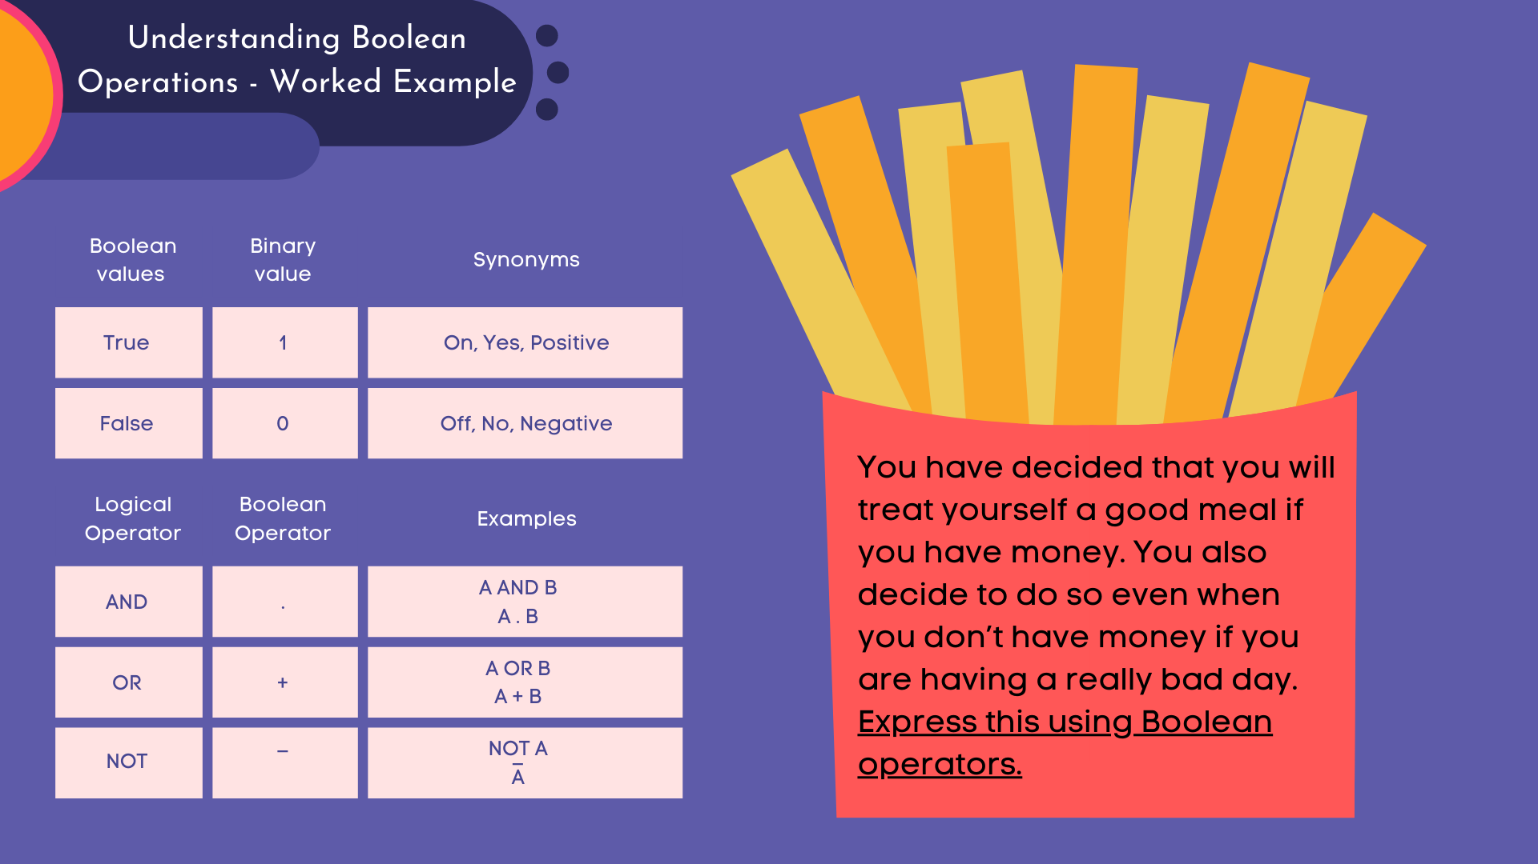

Slide 19
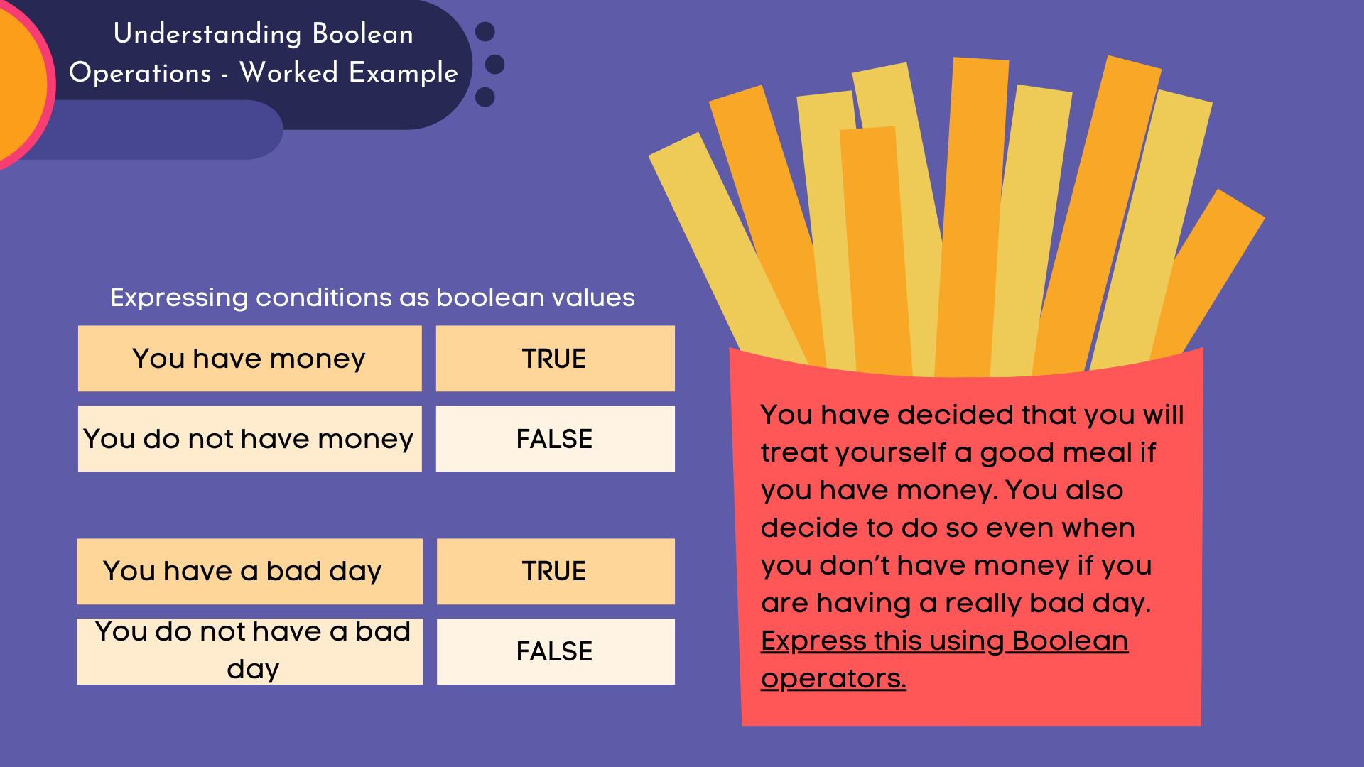
?
?
?
?

Slide 21
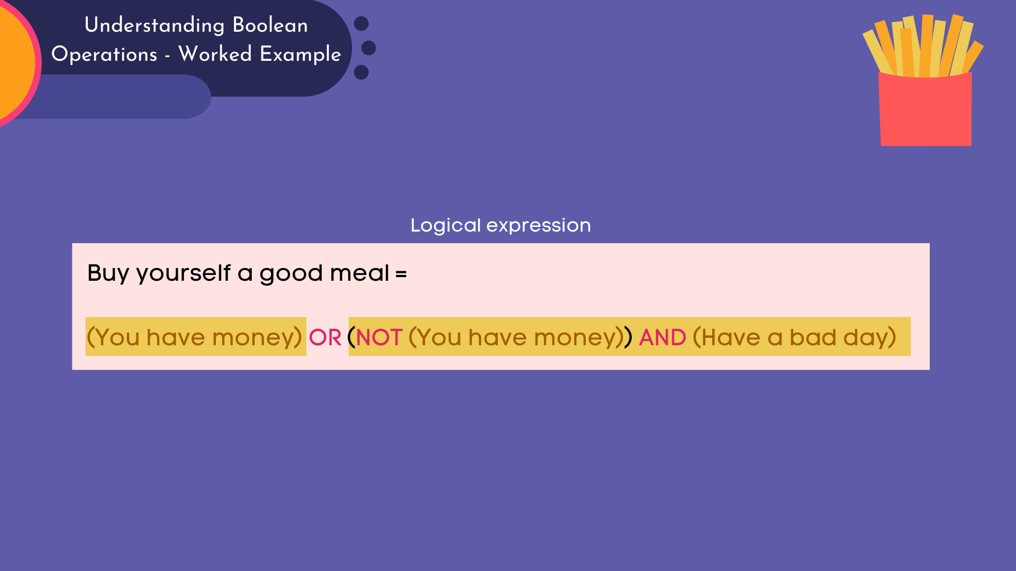

Slide 22


Slide 23
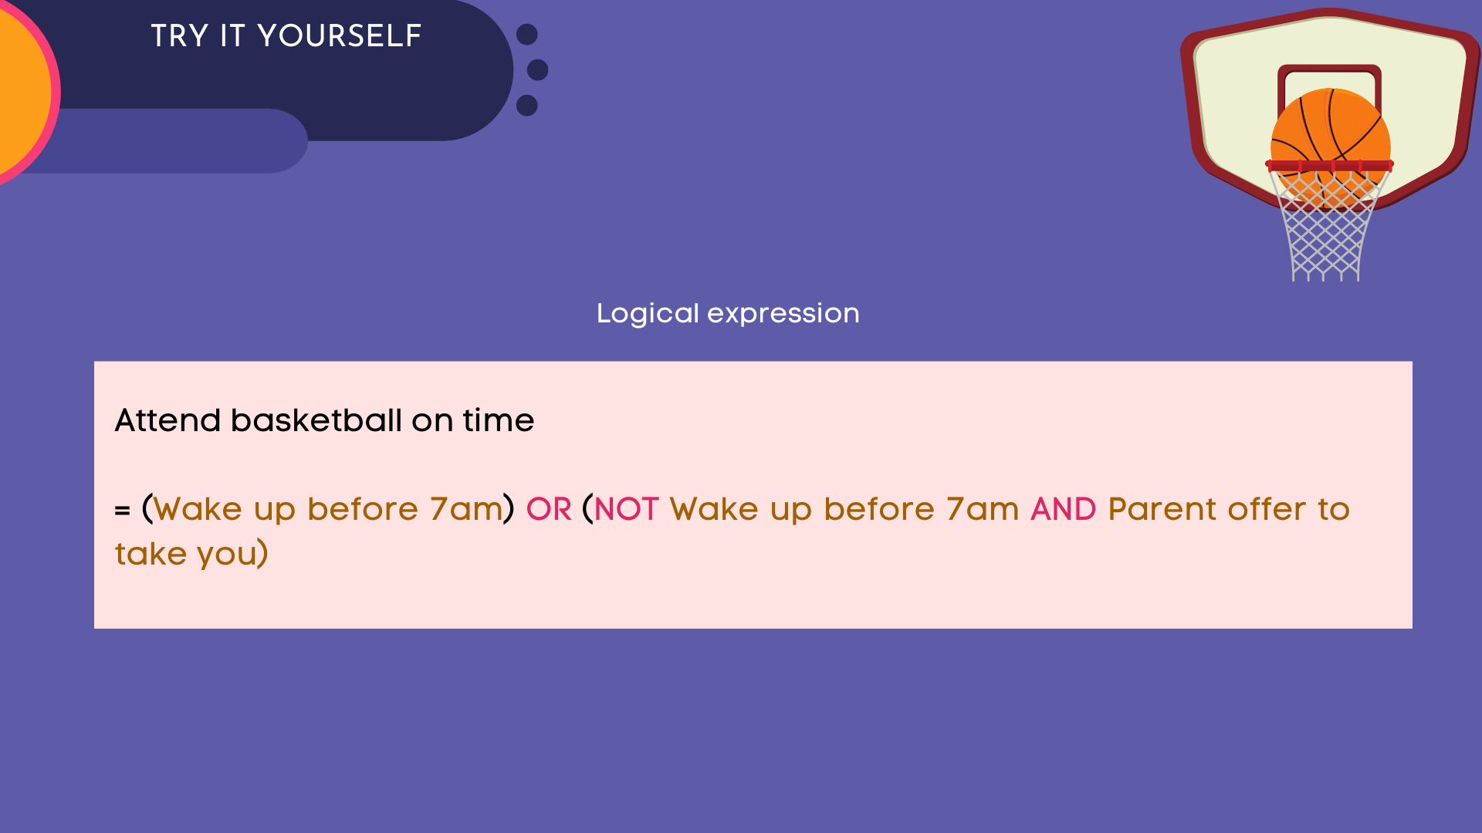
?
?

Slide 25
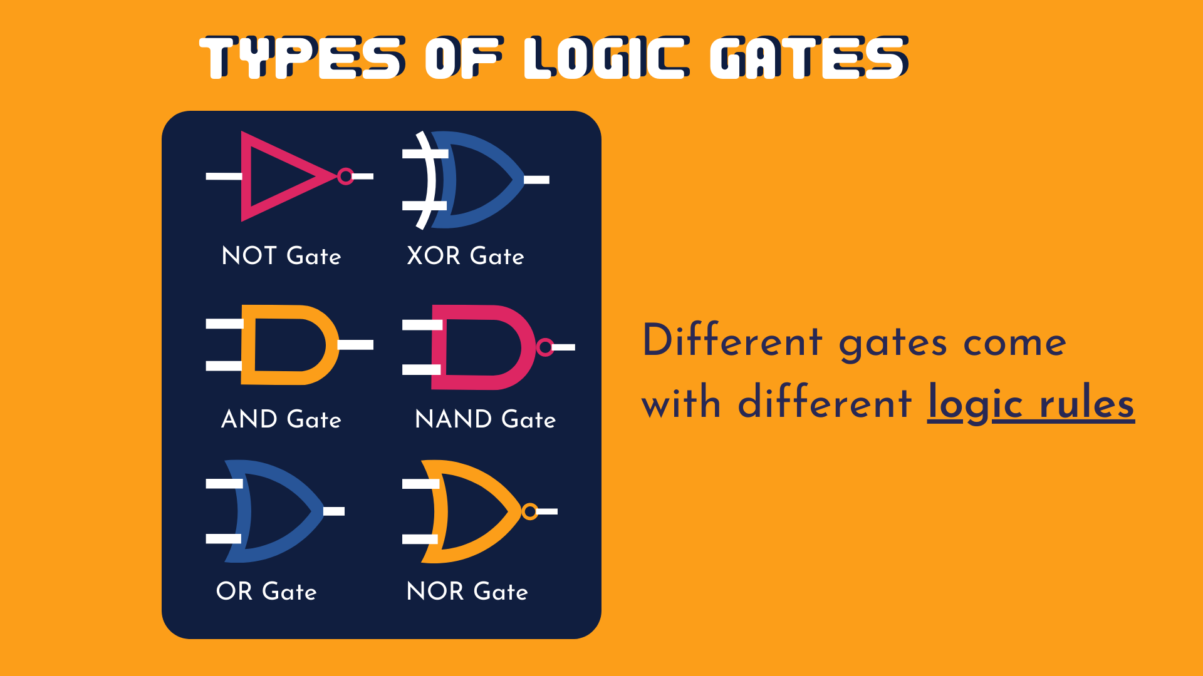

Slide 26
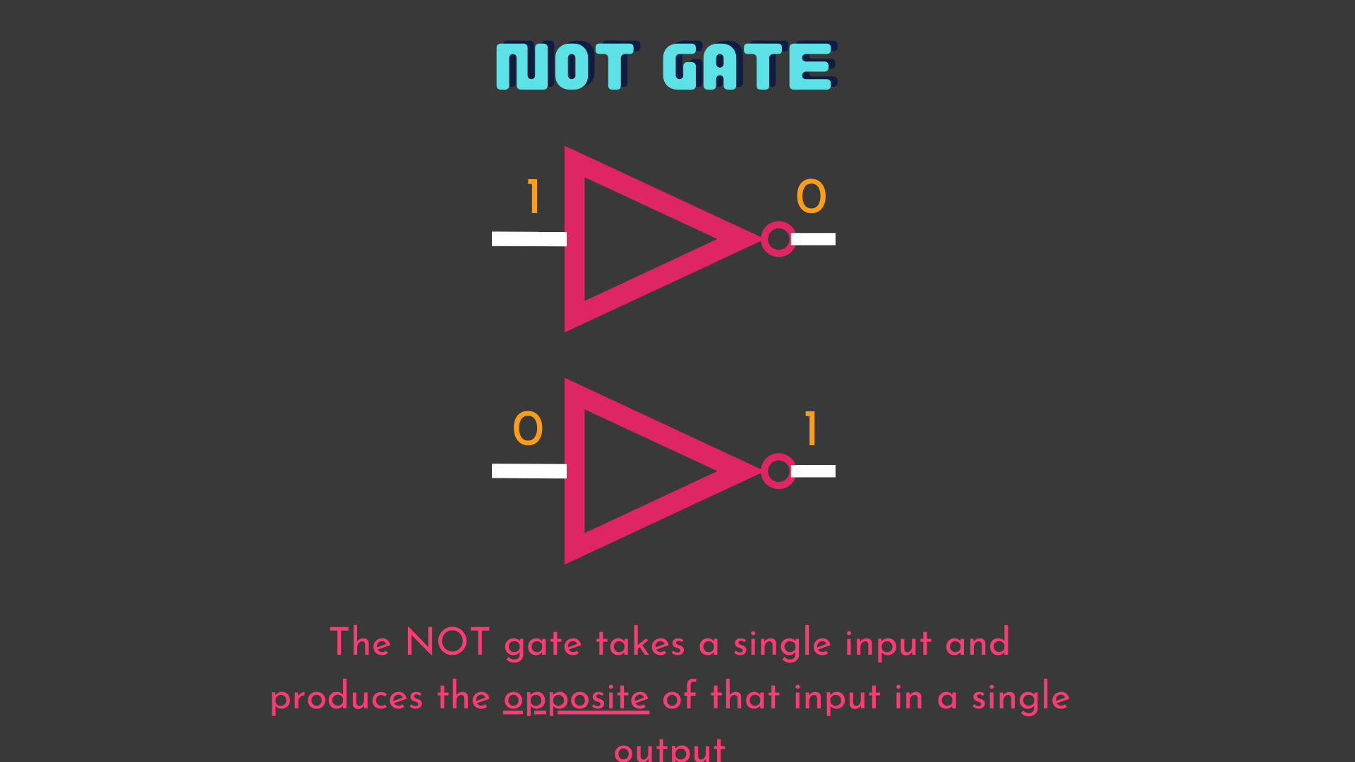

Slide 27
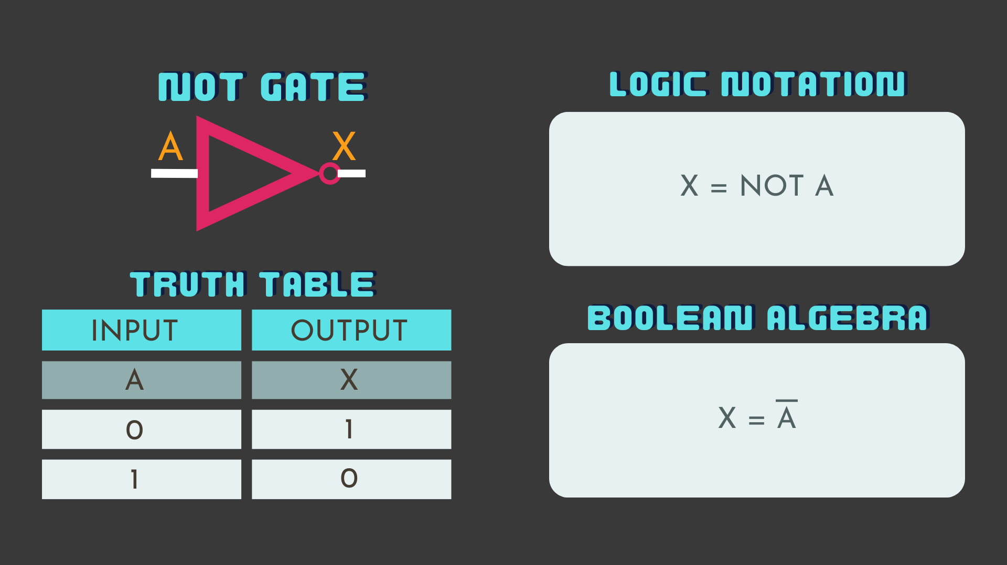

Slide 28
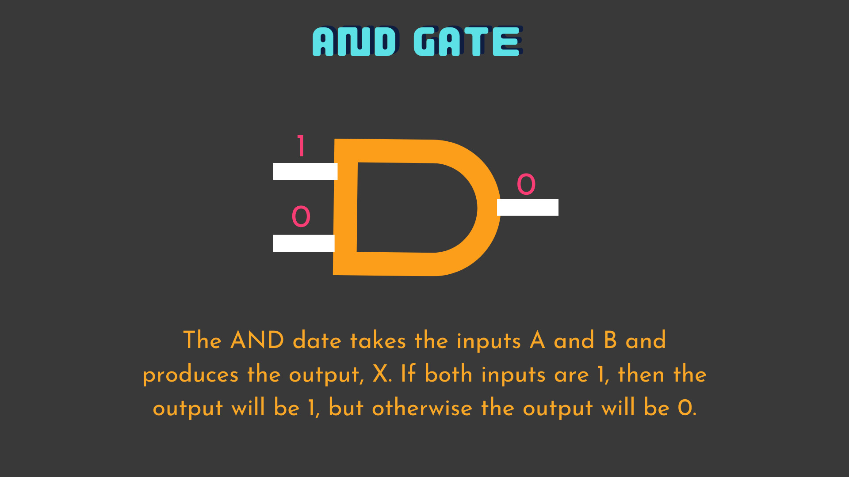

Slide 29
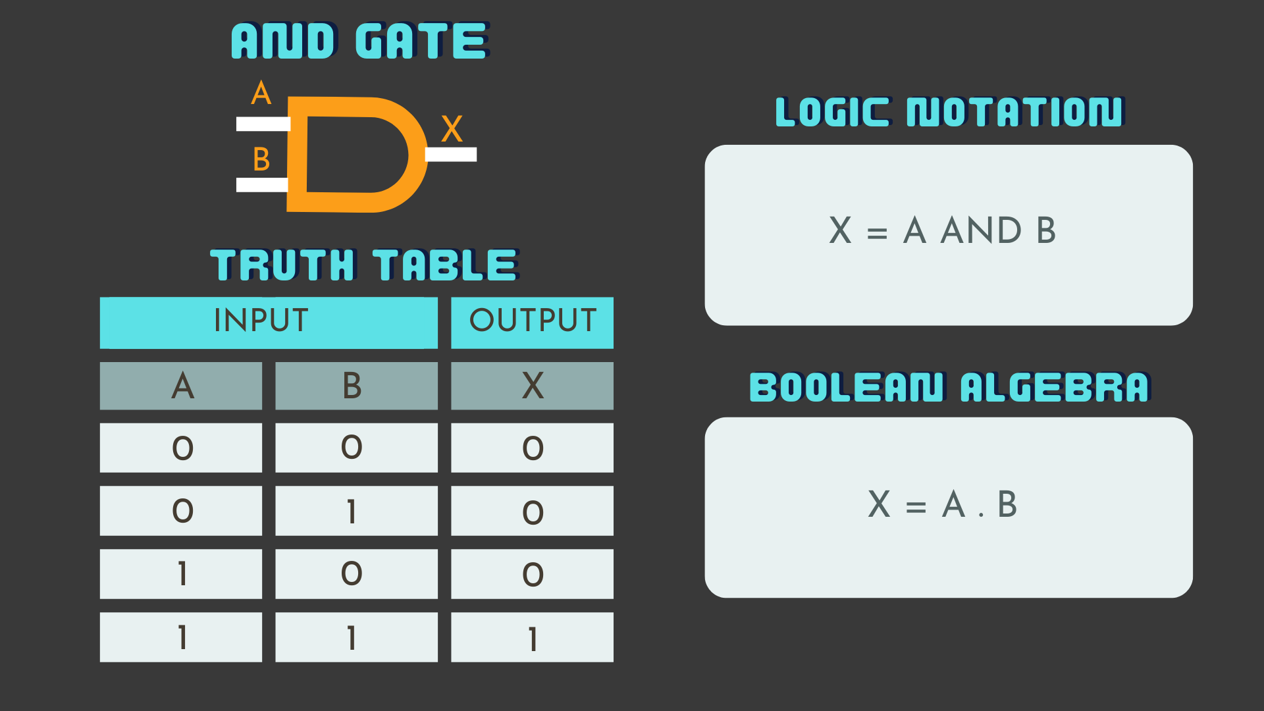

Slide 30
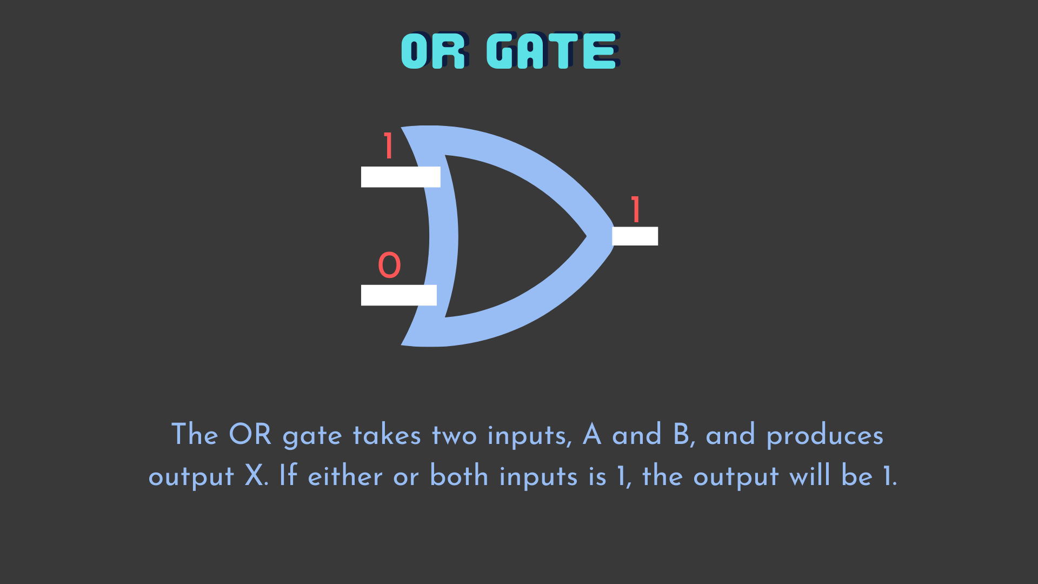

Slide 31
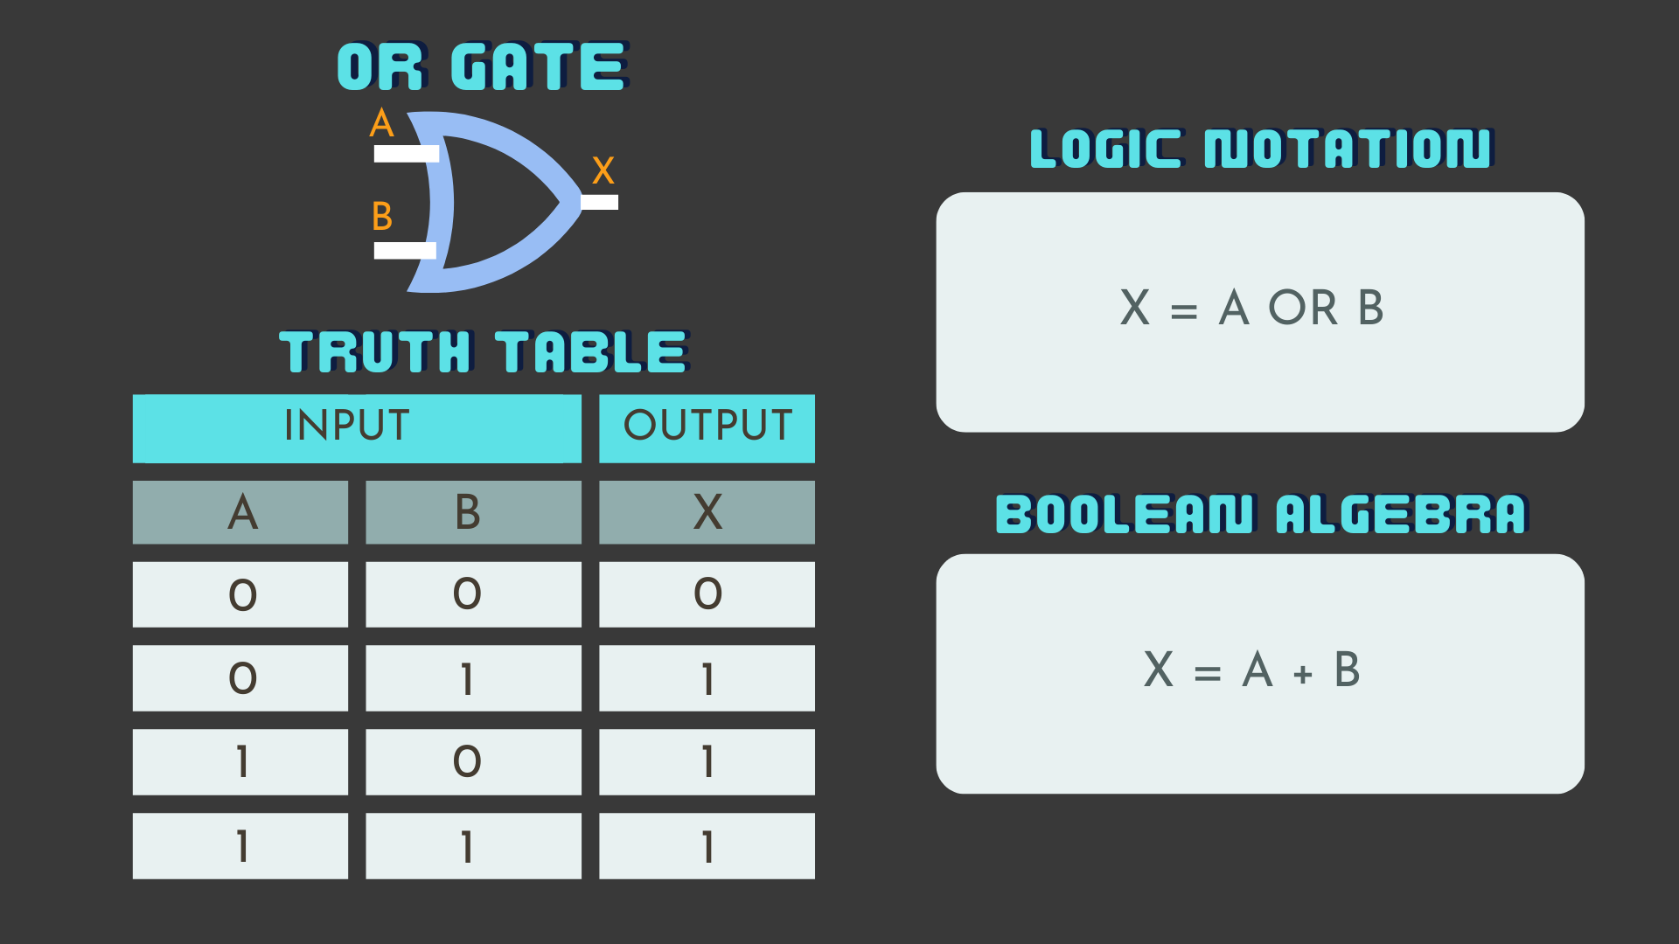

Slide 32
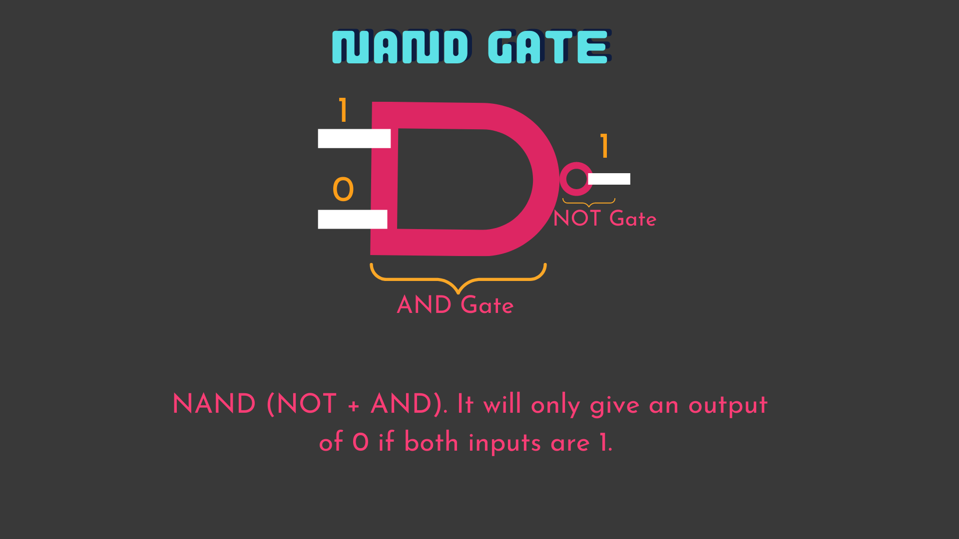

Slide 33
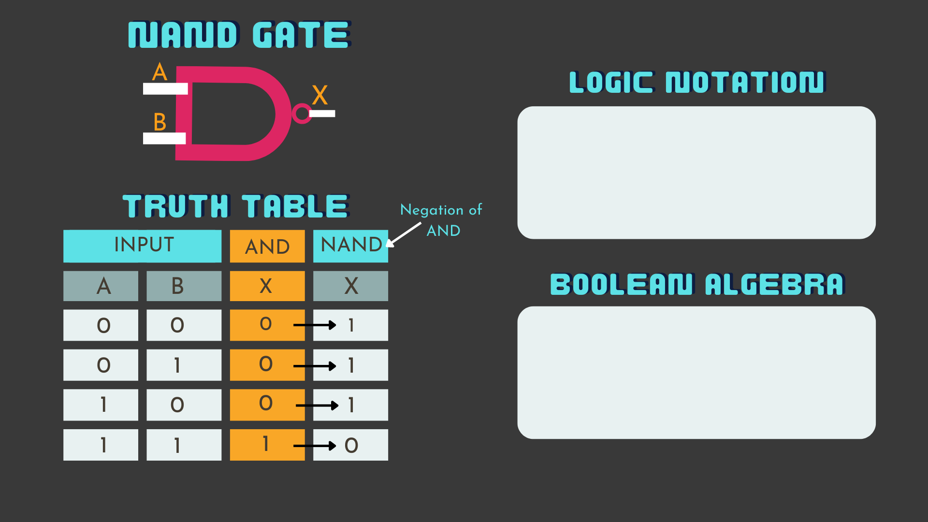

Slide 34
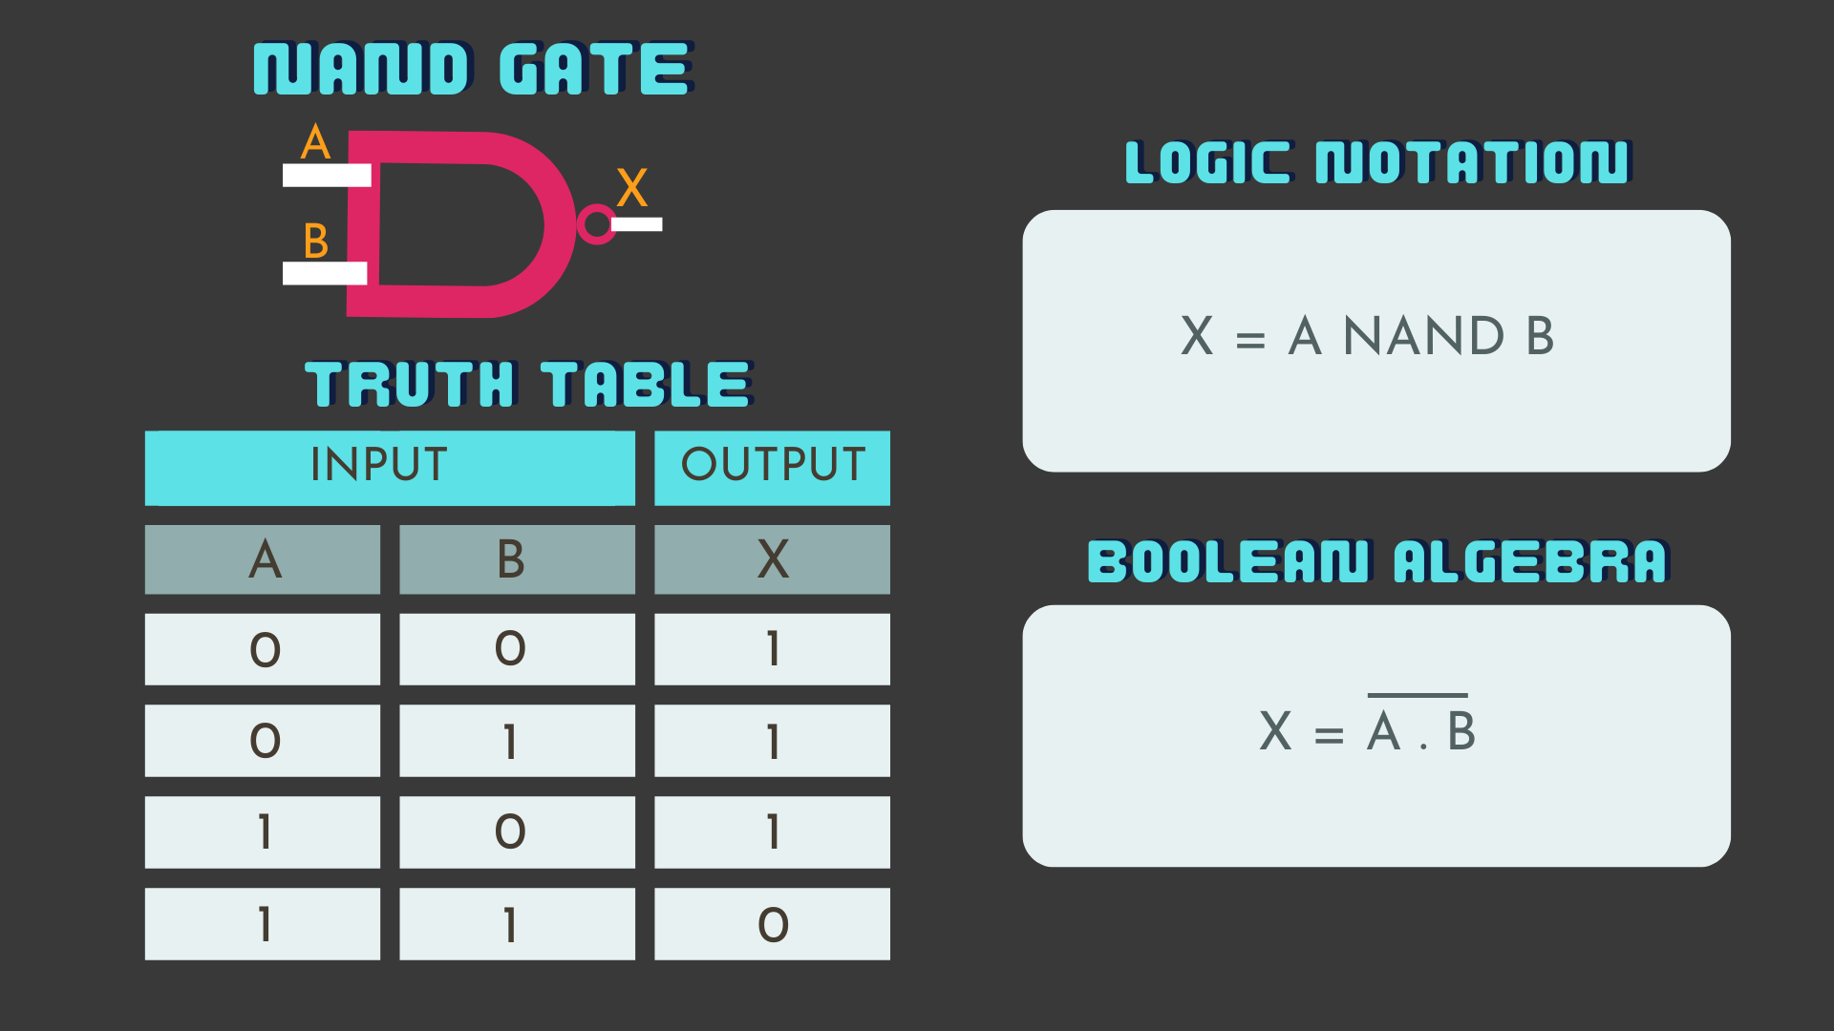

Slide 35
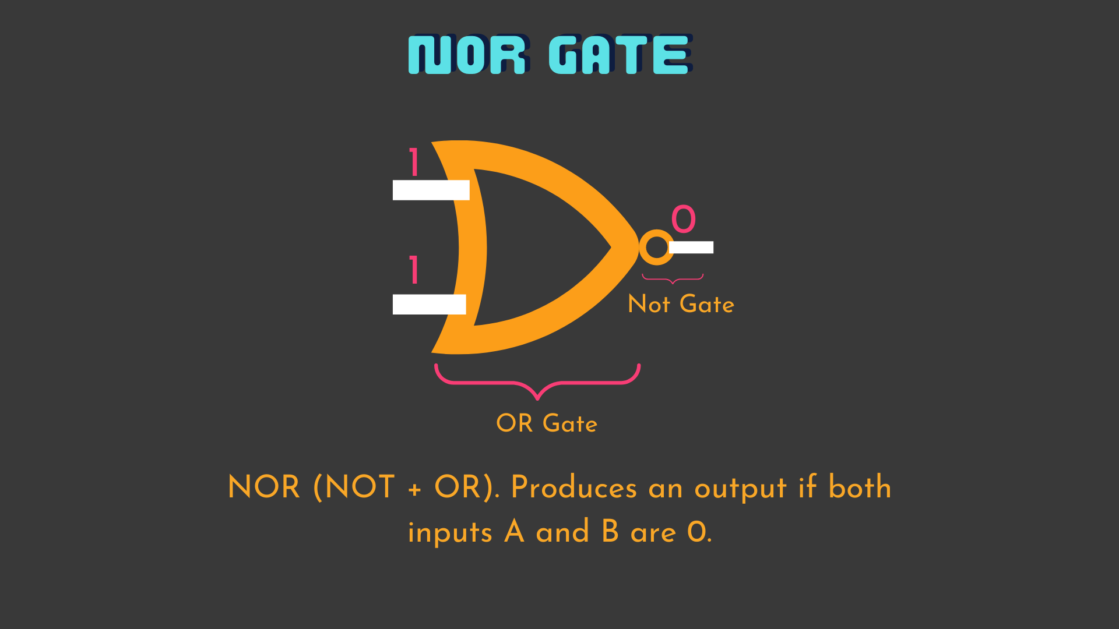

Slide 36
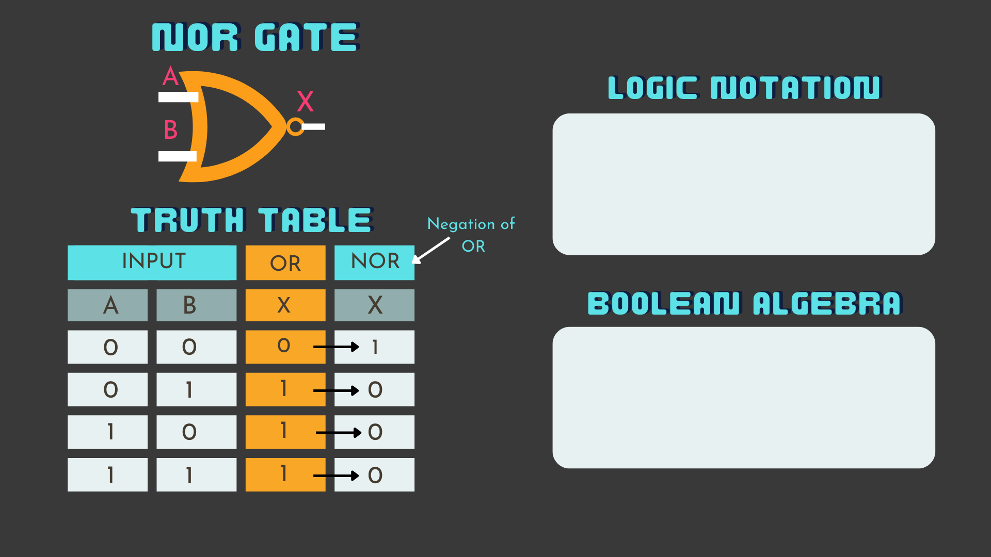

Slide 37
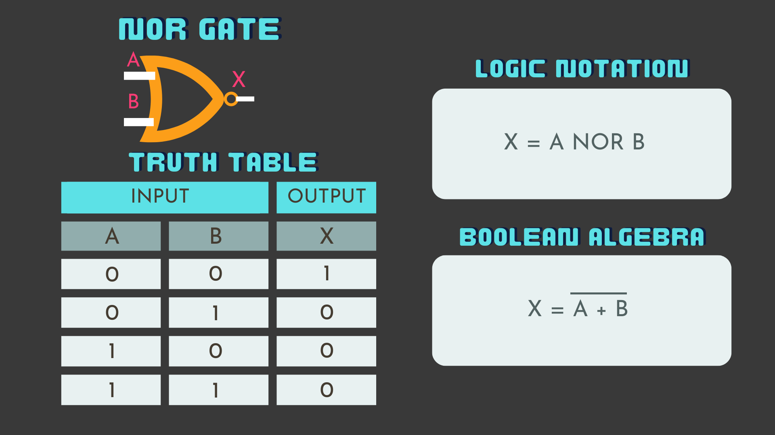

Slide 38
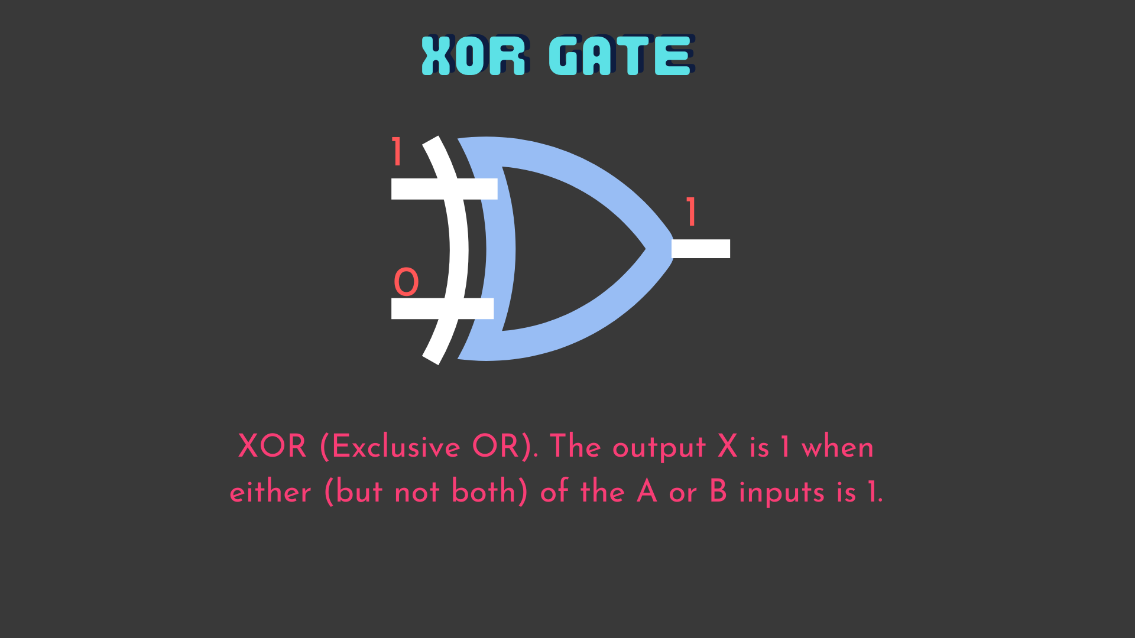

Slide 39
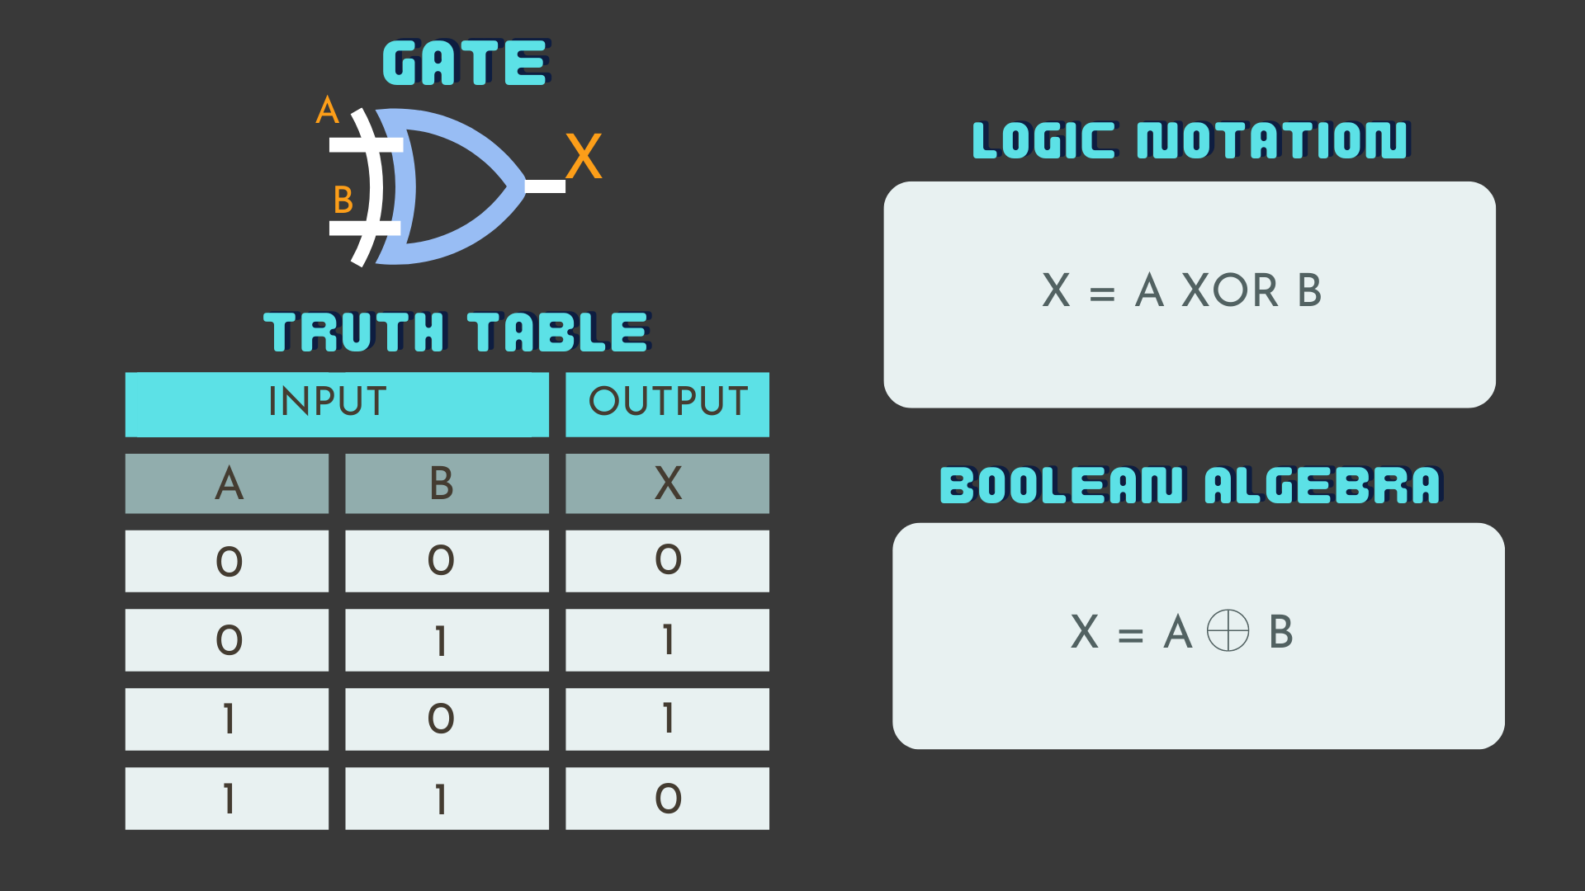

Slide 40

Logic.Ly
https://logic.ly/demo/

Slide 41
Introduction to Logic Gates and Encapsulation
Logic Gates: Logic gates are the fundamental building blocks of digital circuits. They take one or more binary inputs (either 0 or 1) and perform a logical operation to produce an output.
Now, think of logic gates as the internal workings of a system—like a black box. You provide inputs, and the gate processes them to give you an output. like you don’t need to know exactly how the gate processes those inputs; you only care about the inputs and the resulting output.
This concept of hiding the complexity inside while only focusing on what’s necessary for the user is similar to encapsulation in programming.

Slide 42
Let’s Talk About Encapsulation
Imagine you’re using a vending machine. You press a button to get your drink, but you don’t need to know how the machine works inside – you just trust it’ll do what it’s supposed to.
This is the idea behind encapsulation in software development. It hides the complex inner workings of a system and only lets you interact with it in a simple, controlled way.
Now, let’s explore why this concept is so important in creating secure, efficient, and easy-to-manage software.

Slide 43
Key Benefits of Encapsulation:
Simplifies Complexity
Keeps code organized by hiding unnecessary details.
Example: A library system only shows users available books but hides how books are stored in the database.
Protects Data
Prevents direct access to sensitive information.
Example: A banking app ensures account balances can only be updated through secure methods, not directly by users.
Supports Modularity
Each part of a system works independently.
Example: A shopping cart in an e-commerce site can be updated without affecting payment processing.
Improves Maintenance
Makes it easier to update or fix code since changes in one module won’t break others.

Slide 44

Can you think of a real-world example where hiding complexity or controlling access improves functionality?

Slide 45
Can you think of a real-world example where hiding complexity or controlling access improves functionality?
Car Dashboard:
Drivers use the steering wheel, pedals, and buttons to control the car without needing to understand the complex mechanics of the engine or braking system.
Mobile Apps:
Users interact with an app's interface (e.g., sending a message on WhatsApp) without knowing how the backend servers process and deliver the message.
Microwave Oven:
Pressing buttons to heat food without needing to understand how the heating mechanism works internally.
ATM (Automated Teller Machine):
Customers interact with the ATM to withdraw cash, while the internal processes for verifying account balance and dispensing money are hidden.

Slide 46
How Encapsulation Works in Code:
Private Attributes:
Data is kept private (hidden) within a class to prevent unauthorized access or changes.
Example: A bank account class with a private balance (__balance) that can only be accessed through specific methods.
Public Methods:
Provide controlled ways to access or modify the data.
Example: Methods like deposit() and withdraw() let users interact with the balance securely.

Slide 47
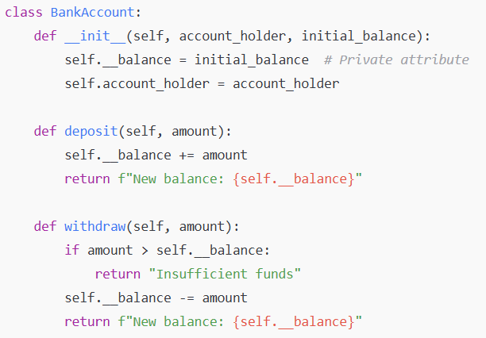

Slide 48

Let’s Try It!
Piggy Bank Worksheet

Slide 49
Exception Handling Best Practices
- Use `try`, `except`, and `finally` blocks.
- Be specific with exception types.
- Always close resources in `finally` or use context managers.

Slide 50
Graph Traversal Algorithms
- Breadth-First Search (BFS): Explores layer by layer.
- Depth-First Search (DFS): Explores as deep as possible before backtracking.
- Applications: Social networks, pathfinding.

